Slide 1
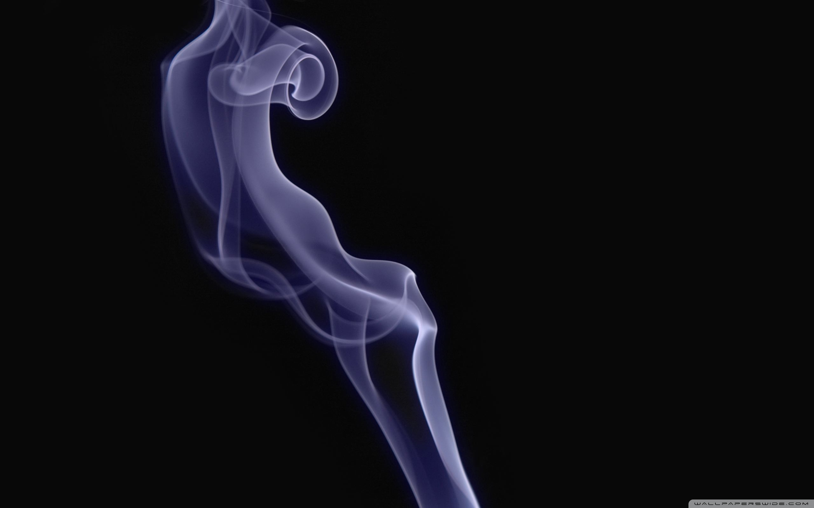
IMAGE CLASSIFICATION
iTrainer 1.0
Notes:
Welcome to our iTrainer 1 product release

Slide 2
PRESENTATION MAP
About Our Project
Task Architecture
Methodology
Feature extraction
Algorithm training process
Model comparison
Gradient Boosting Machine
iTrainer Results
About us
Notes:
presentation workflow

Slide 3
About Our Project
Our basic task is to create an algorithm to classify whether an image contains a dog or a fried chicken. The input for this task is images of poodle dogs or fried chicken from training dataset, while the output is the classification accuracy on test dataset.
Our training set contains 2000 images, including 1000 images of poodle dogs and 1000 images of fried chicken.
Our learning task is to learn a classification model to determine the decision boundary for the training dataset.
Our performance task is to apply the learned classification model to classify images from the test dataset, and then evaluate the classification accuracy.

Slide 4
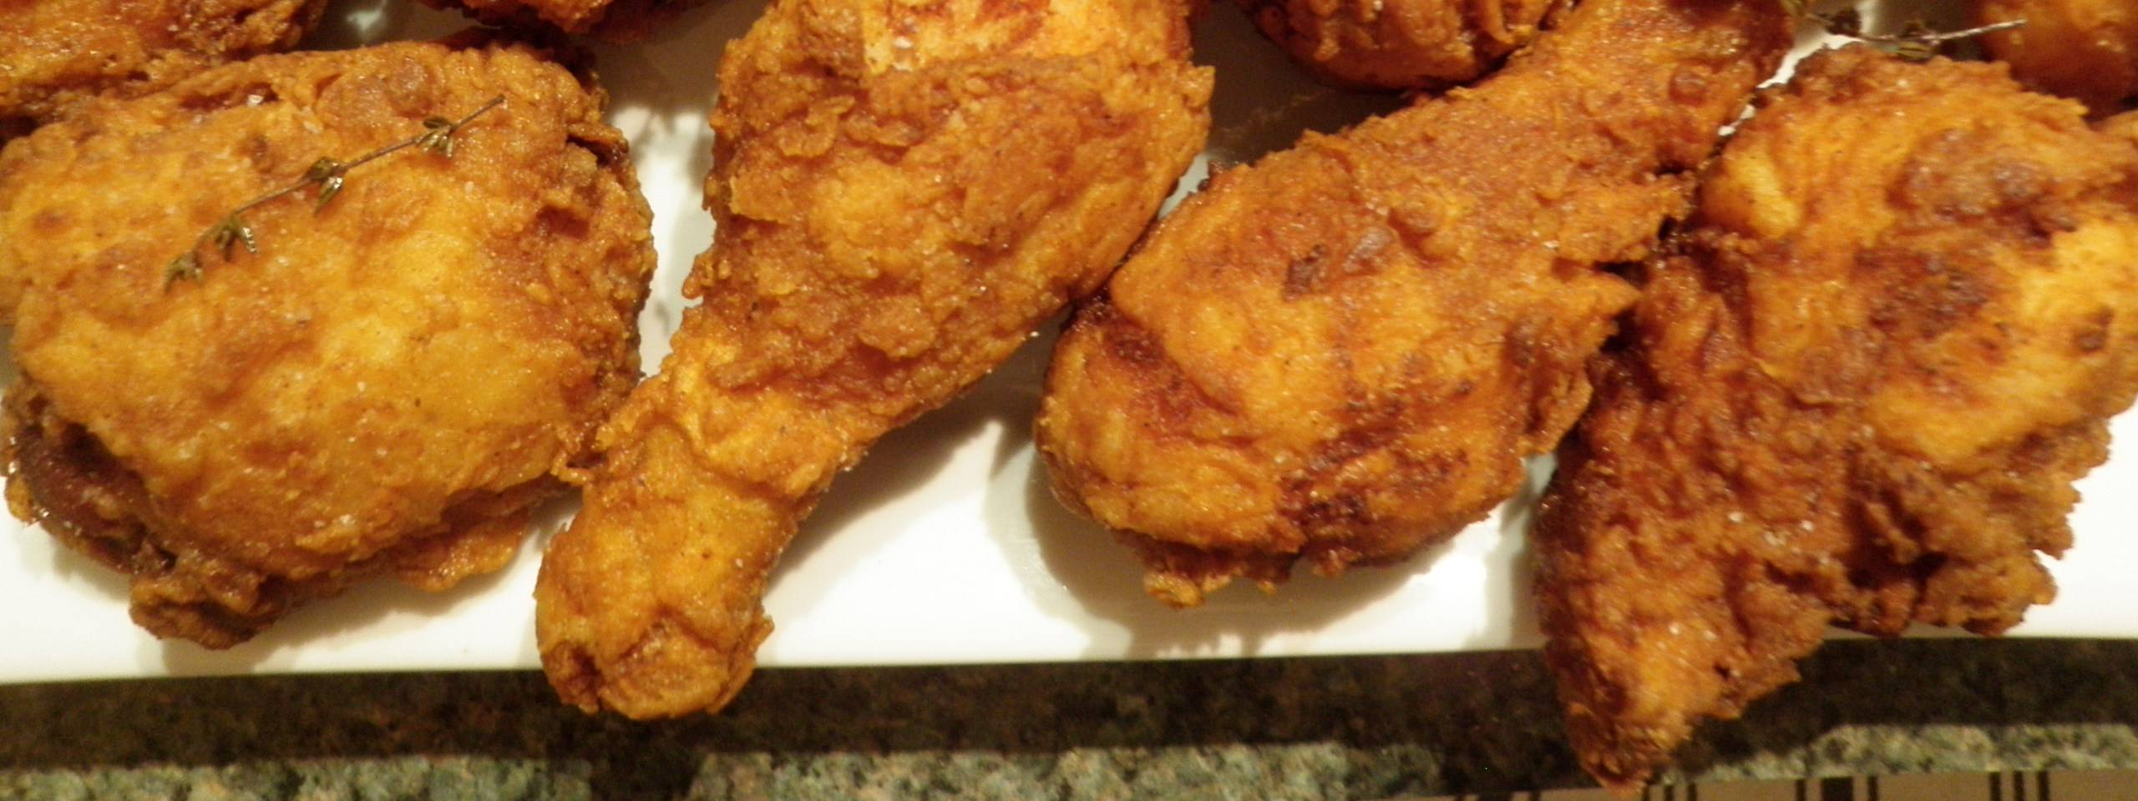
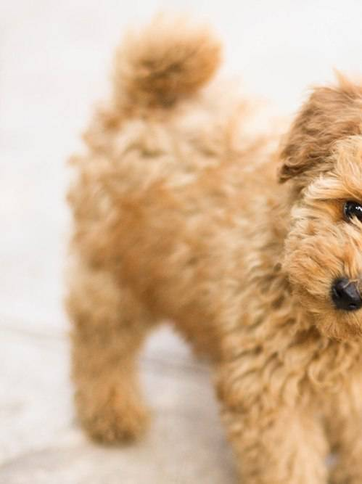
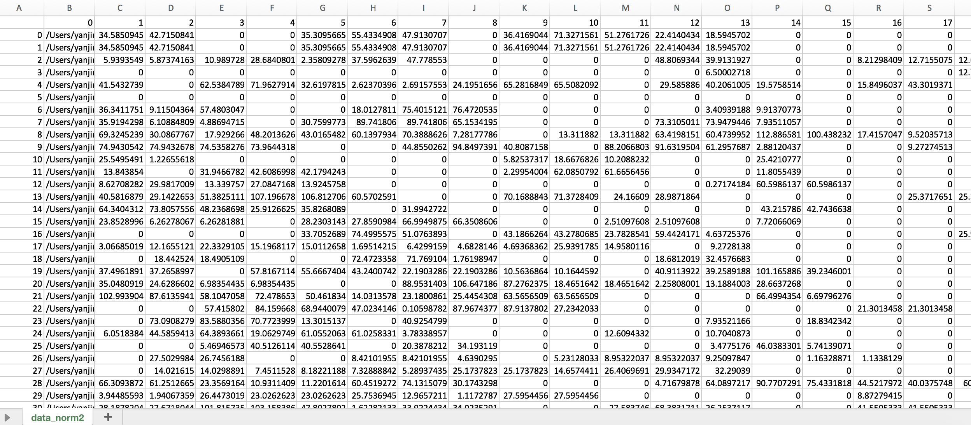
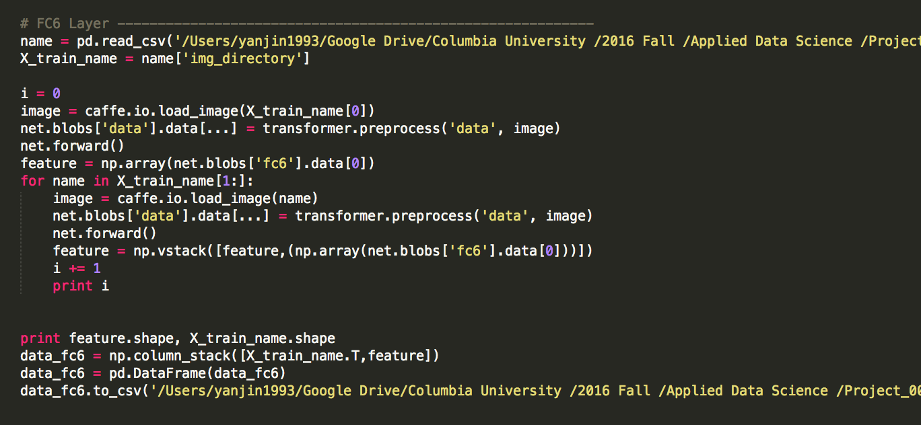
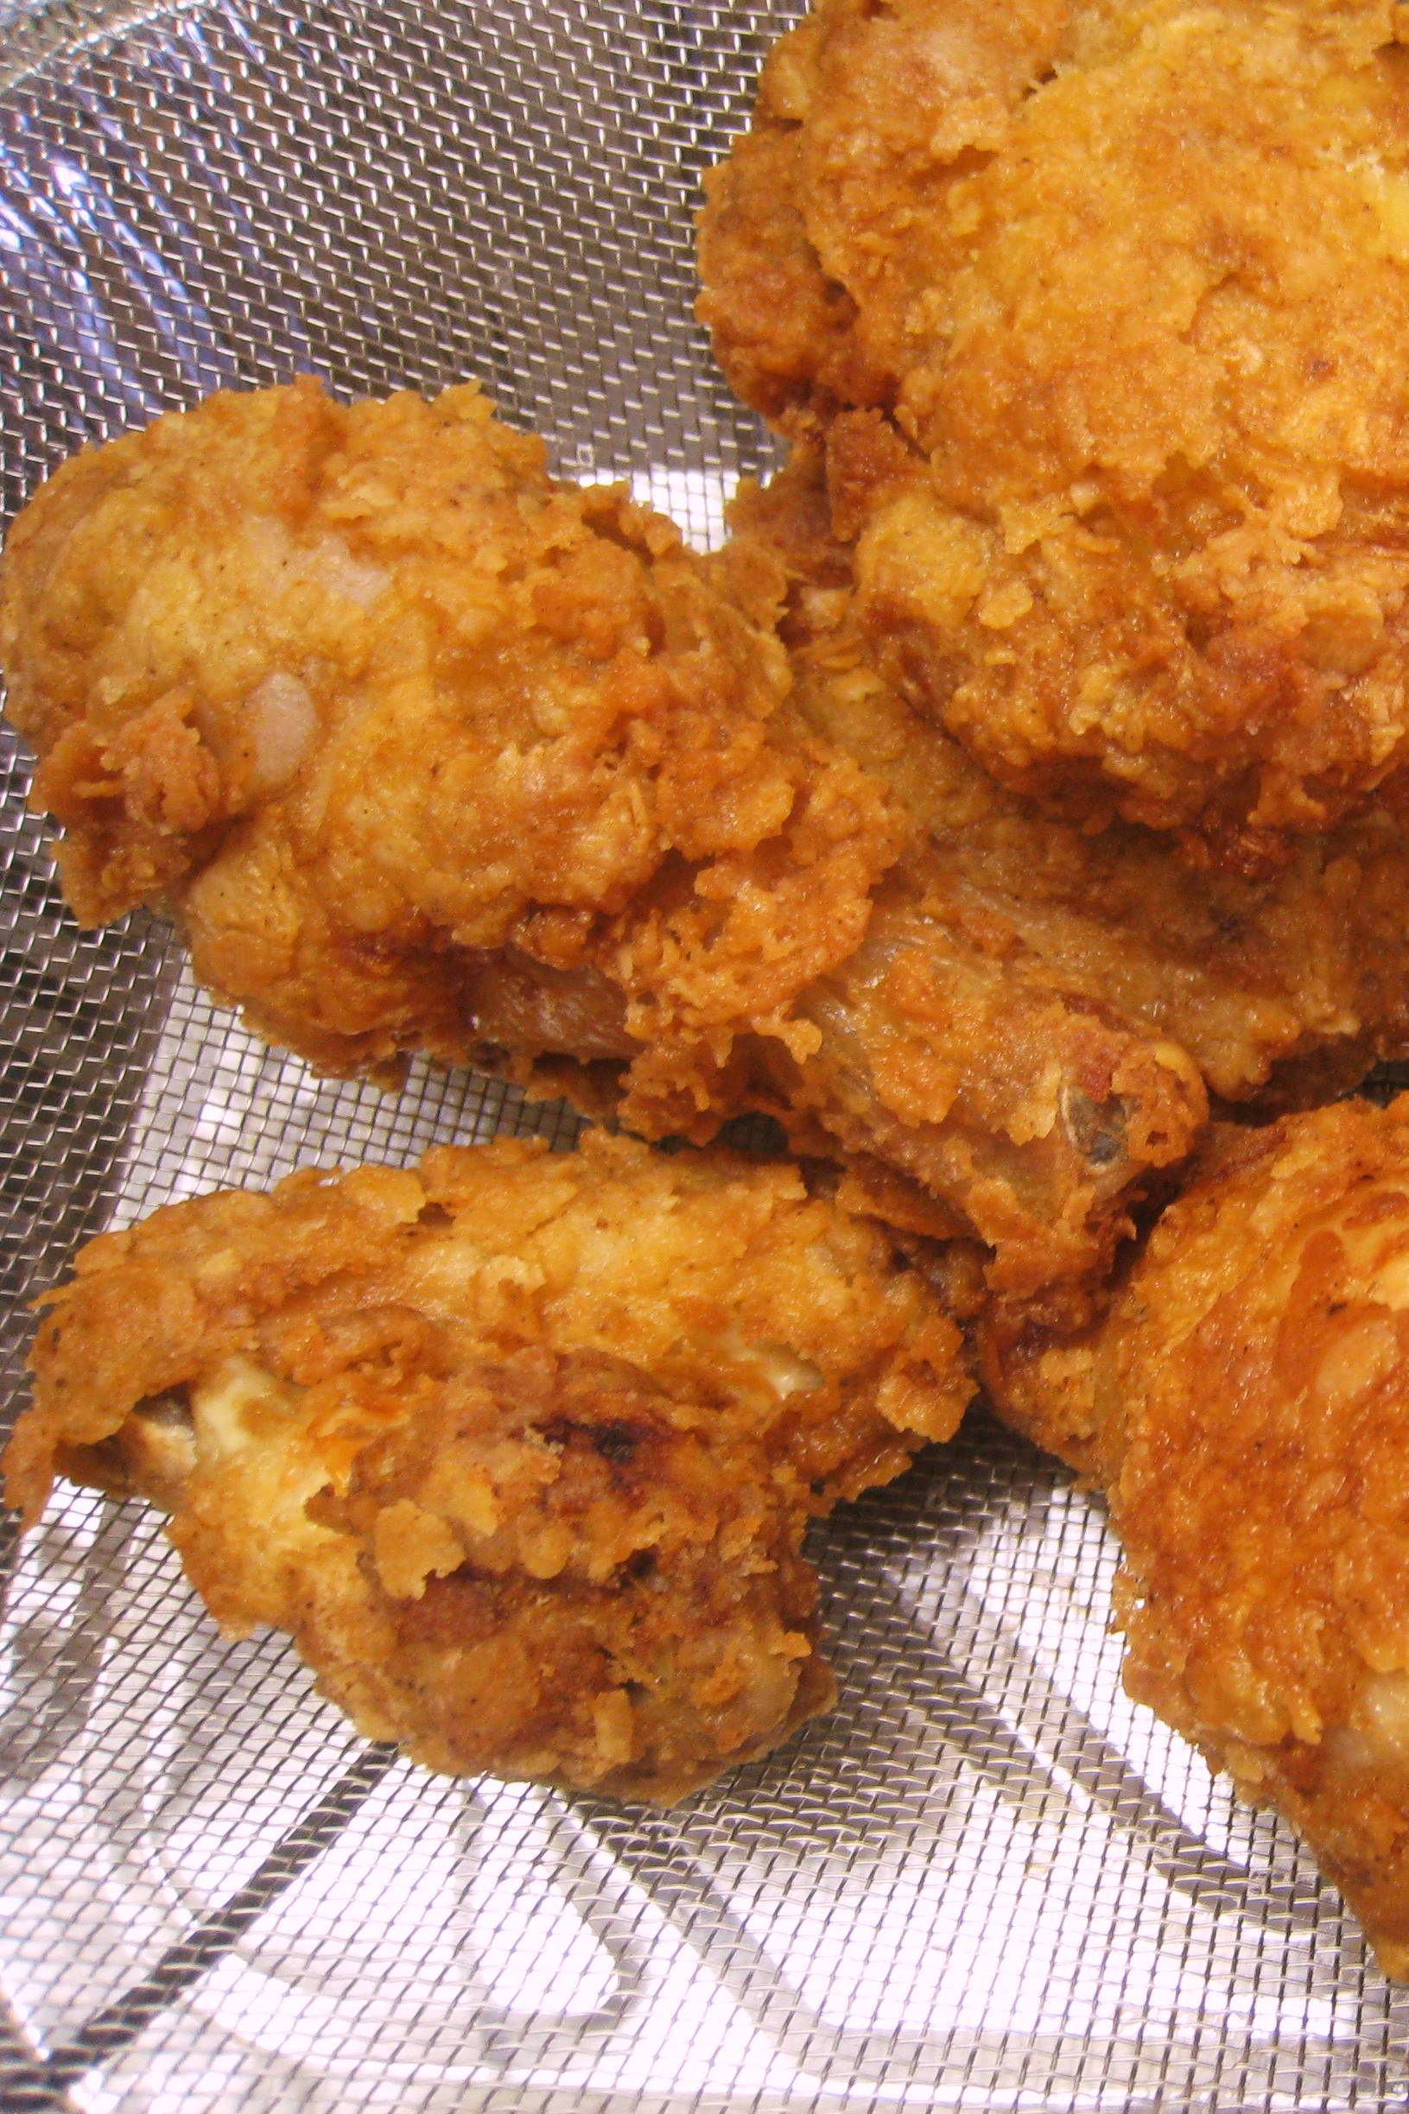
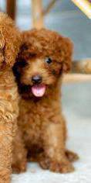
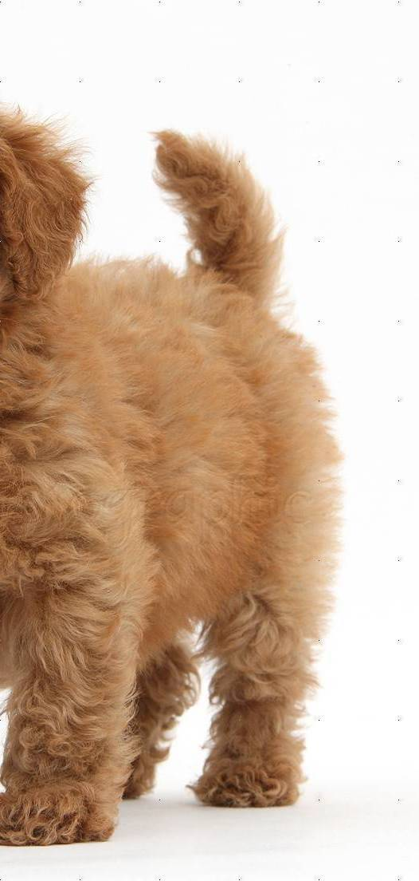
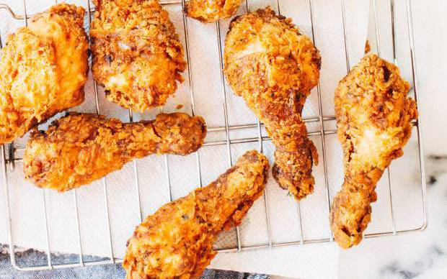
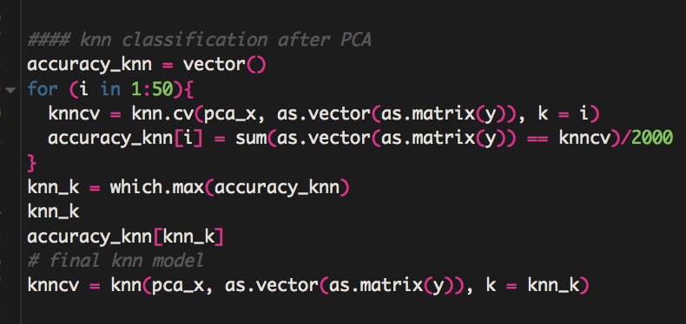
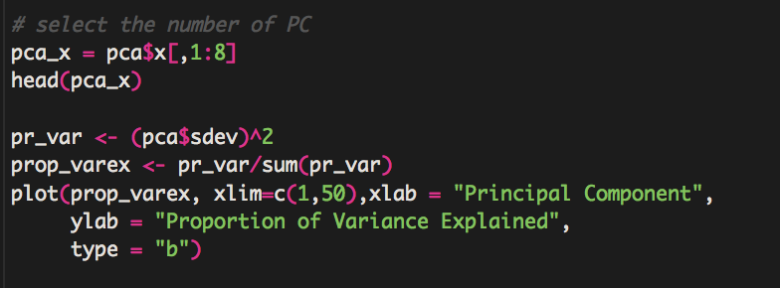
Architecture for Learning/Performance Task
Training Dataset
Feature Vector Space
Feature Extraction
Prediction Labels
Classifier Training
Real Labels
0, 1, 0, 1, 1, 1, 0, 1, 1, 0, 0, 0, 1, 1, 1, 0, 1, 1 …
Accuracy
0, 1, 0, 1, 1, 1, 0, 1, 0, 1, 0, 0, 1, 0, 1, 1, 0, 1 …

Slide 5
iExtractor Overview (Feature Extracting Process)
Human-Crafted
(Computer Vision OpenCV2)
Trainable
(Deep Learning Framework Caffe)
MSER
(Maximally Stable Extremal Regions)
SIFT
(Scale-invariant Feature Transformation)
CNN
(Convolutional Neural Network)
Corner
(Harris Corner Detection)
HoG
(Histogram of Oriented Gradients)
Notes:
The first method is a traditional pattern recognition model, by which we learned the classification model from some human-crafted features,
Deeper perspective to understand the hidden patterns within images

Slide 6
iClassifier Overview (Classification Training Process)
iExtractors
(Human-crafted and Trainable)
iClassifiers
(Simple classifiers)
iBooster
(Gradient Boosting Machine)
SIFT
SVM
(Support Vector Machine)
MSER
Harris Corner
GBM
(Gradient Boosting Machine)
KNN
(k-Nearest Neighbors)
CNN
HoG
Logistic
(Logistic Regression)

Slide 7
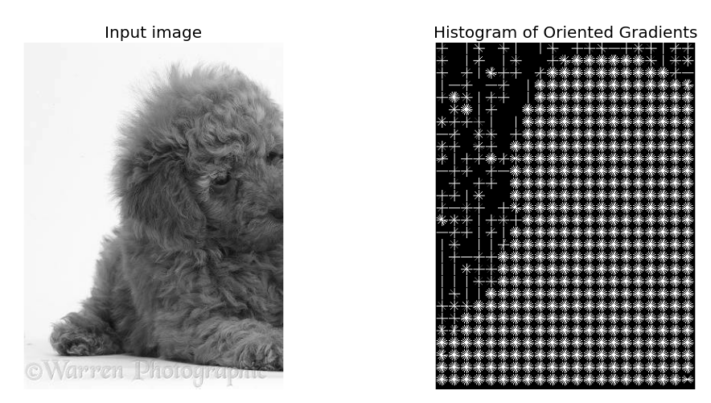
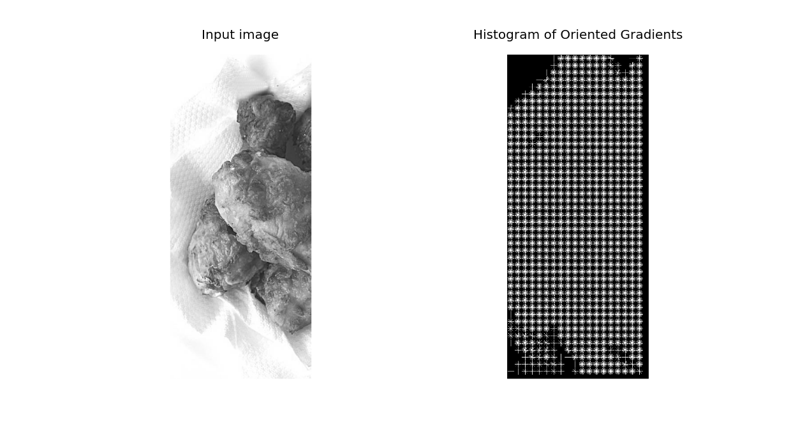
iExtractor HOG + iClassifier Log
It is invariant to geometric and photometric transformations, except for object orientation.
The HOG descriptor is particularly suited for human detection in images. (object detection systems)
Face-detection instead of recognition. Location detection.
Logistic
(Logistic Regression)
HoG
56.81%

Slide 8

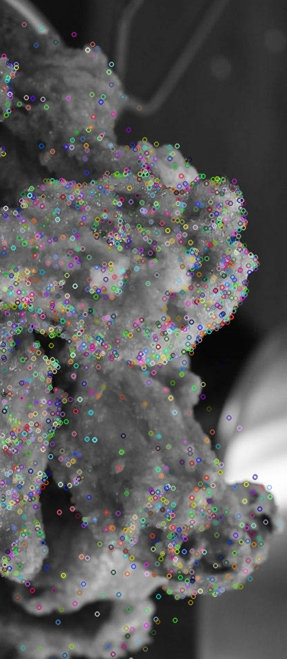
iExtractor SIFT + iClassifier KNN
Scale-invariant feature transform (or SIFT) is an algorithm in computer vision to detect and describe local features in images.
Given SIFT's ability to find distinctive keypoints that are invariant to location, scale and rotation, and robust affine transformation (changes in scale and position) and changes in illumination, they are usable for object recognition.
KNN
(k-Nearest Neighbors)
SIFT
63.10%
Notes:
!!!!!!

Slide 9
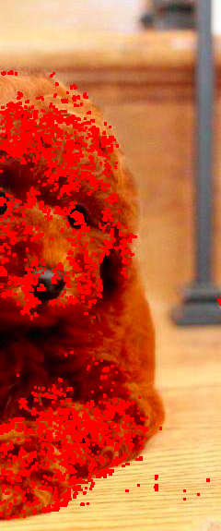
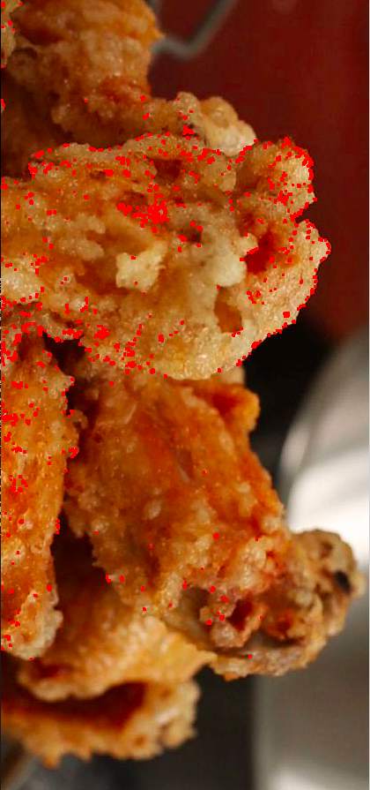
iExtractor Harris Corner + iClassifier KNN
Corner is the intersection of two edges, it represents a point in which the directions of these two edges change.
Hence, the gradient of the image (in both directions) have a high variation, which can be used to detect it.
Harris Corner
KNN
(k-Nearest Neighbors)
66.25%

Slide 10
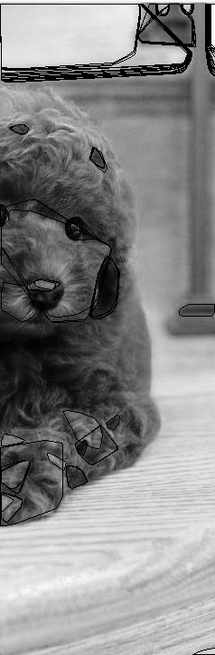
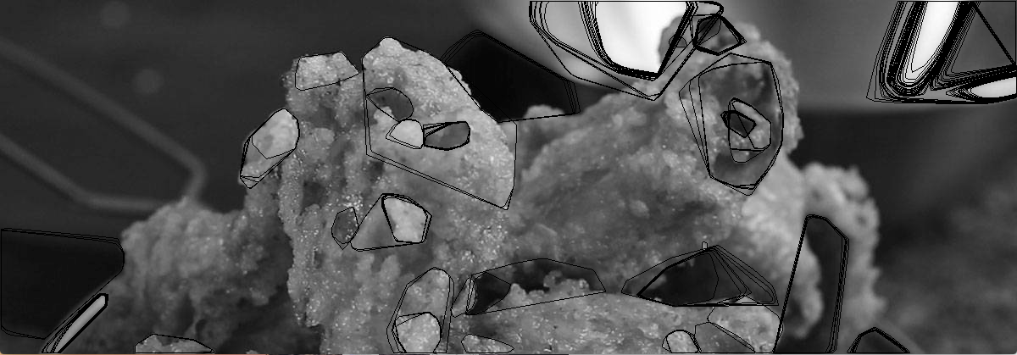
iExtractor MSER + iClassifier SVM
The algorithm identifies contiguous sets of pixels whose outer boundary pixel intensities are higher (by a given threshold) than the inner boundary pixel intensities. Such regions are said to be maximally stable if they do not change much over a varying amo
Stability: Regions whose support is nearly the same over a range of thresholds is selected.
unt of intensities.
SVM
(Support Vector Machine)
75.17%
MSER
Notes:
Texture pixel intenseities

Slide 11
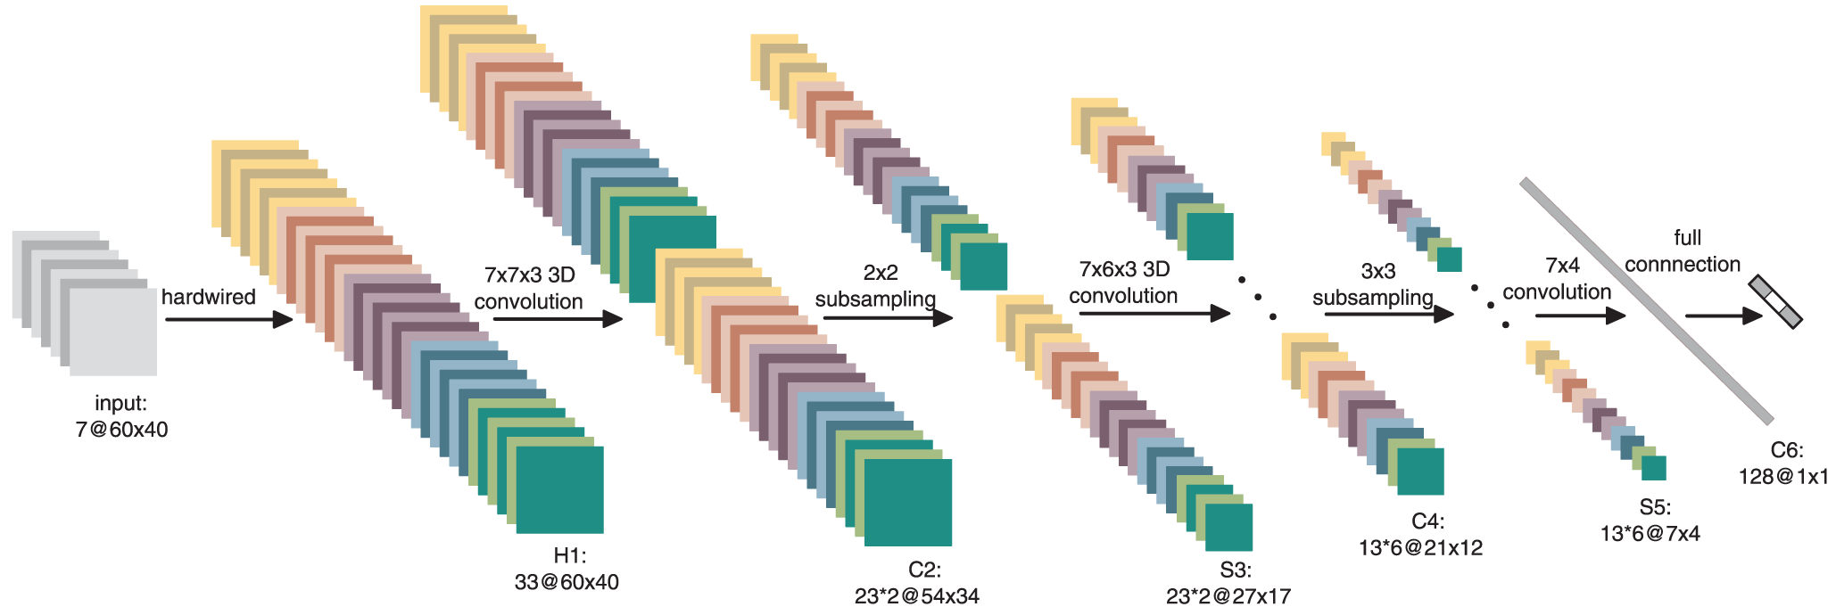
iExtractor CNN Intro
Convolutional layers contain many feature maps, which are two dimensional hidden nodes. Every feature map owns a weight matrix called kernel, and different feature maps owns different kernels. Kernels do convolutional operation with every feature map in previous layer (layer j), then we sum them up and put it into sigmoid function.
Notes:
Convolutional layers contain many feature maps,
hidden nodes.
To clearly understand how CNN work, here we look insight into the internal operation
First we'll see how to read out the structure of the net in terms of activation and parameter shapes. Here is the structure under activation and parameter layers.

Slide 12
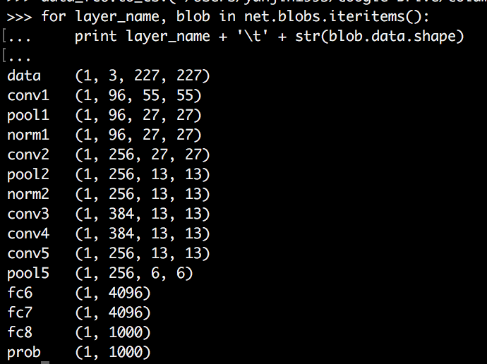
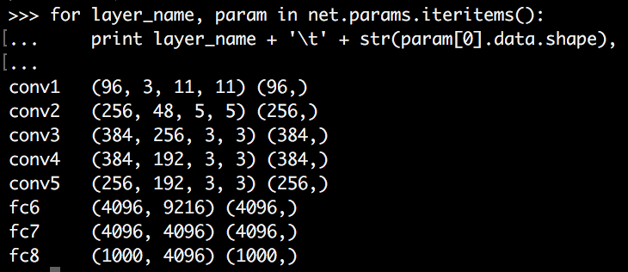
iExtractor CNN Layers
Activation/Neuron Layers
(batch_size, channel_dim, height, width)
Parameter/Data Layers
(output_channels, input_channels, filter_height, filter_width)
Notes:
The projections from each layer show the hierarchical nature of the features in the network.
Surface layer learns some basic edges and colors.
Next follow layer responds to corners and other edge/color conjunctions
Next deeper one has more complex invariances, capturing similar textures or patterns
Next deeper shows significant variation, but is more class-specific
At the deepest level, layer shows entire objects with significant pose variation
To understand what every layers learned from images, we need to figure out what kind of inputs activate a feature map. To clearly understand what these layers indicate, we visualized the norm1 and conv1 layers.

Slide 13
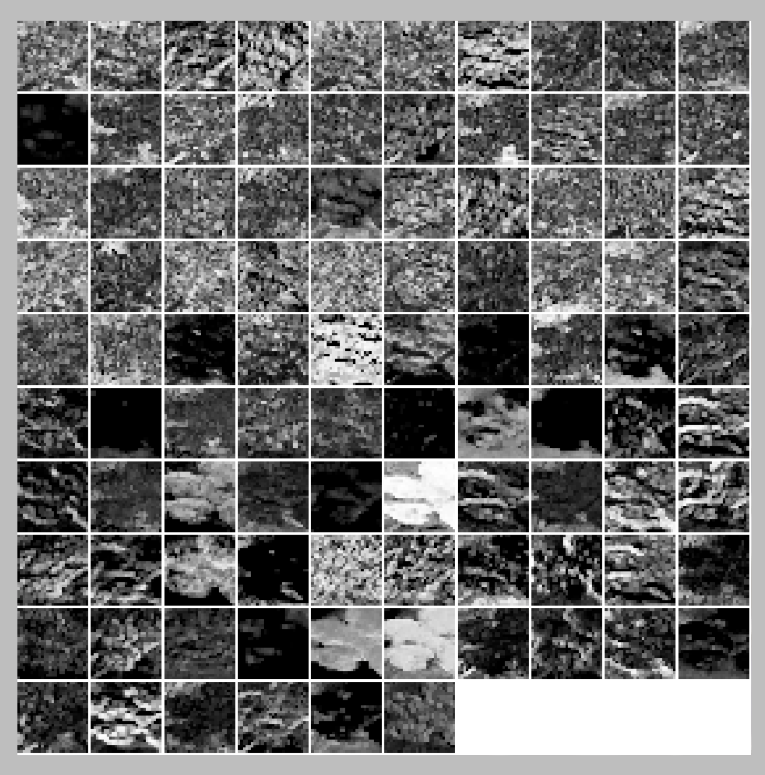
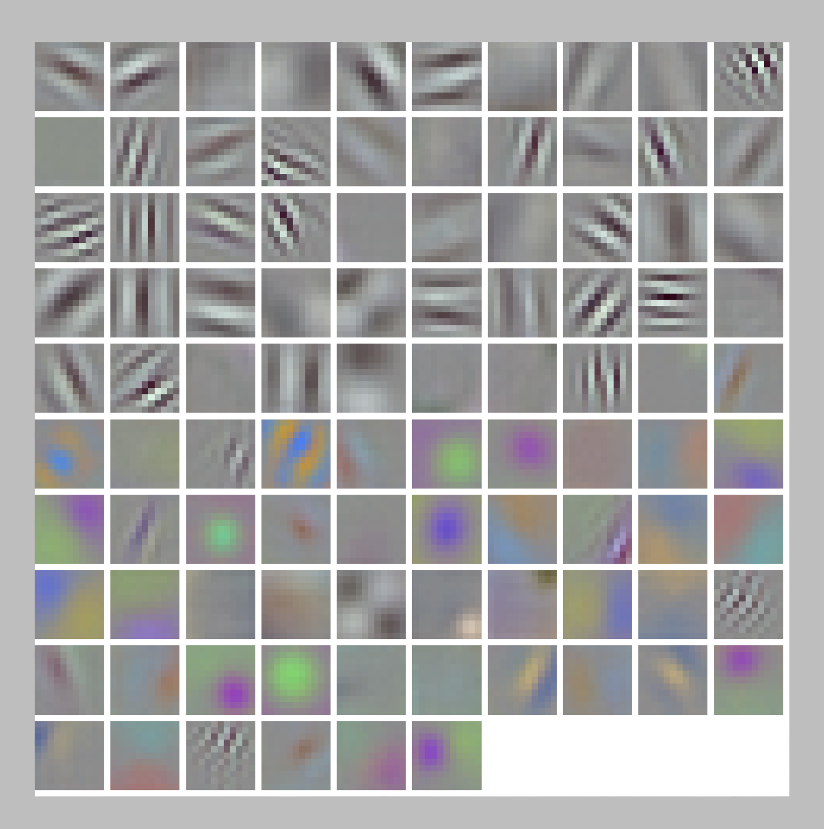
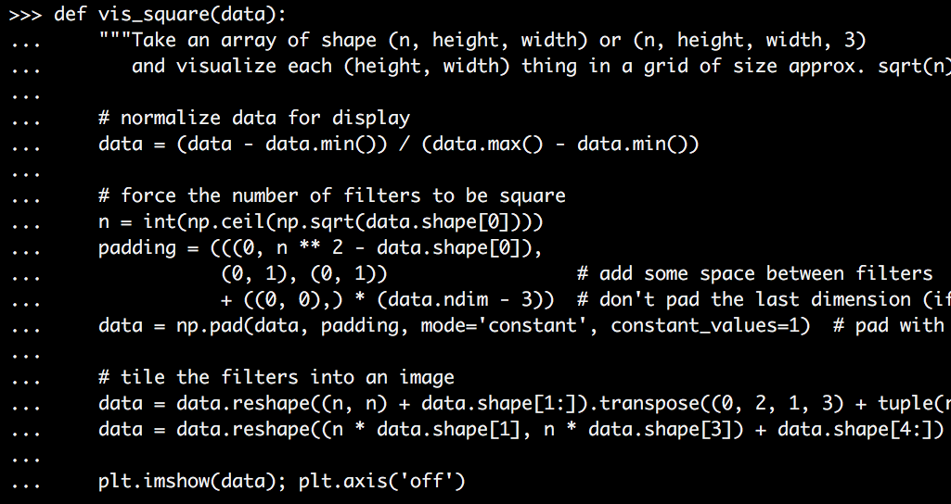
iExtractor CNN + iClassifier SVM
Norm1 Layers
Conv1 Layer
CNN Nrom2 Layer
PCA
(5 PC)
SVM
(Support Vector Machine)
90.93%
Notes:
With more hidden layers, the learned features become more high level and specific. Compared to human-crafted features such as SIFT or color features,
they are more expressive, class-specific
the deeper the more invariant to backgrounds. -> the better
Dimension reduction: 40k -> 5 explains ~50% variation

Slide 14
iTrianer Results
iExtractor
iClassifier
Accuracy
CNN fc6 Layer
Logistic
(Logistic Regression)
49.38%
HoG
Logistic
(Logistic Regression)
56.81%
KNN
(k-Nearest Neighbors)
SIFT
63.10%
KNN
(k-Nearest Neighbors)
66.25%
Harris Corner
MSER
SVM
(Support Vector Machine)
75.17%
SVM
(Support Vector Machine)
CNN Nrom2 Layer
90.93%
Notes:
Even
18 different combinations
Not across different classifiers
review

Slide 15
iBooster Results
iExtractor
iBooster
Accuracy
GBM
(Gradient Boosting Machine)
SIFT
71.05%
GBM
(Gradient Boosting Machine)
CNN Nrom2 Layer
73.50%
Notes:
Even
18 different combinations
Not across different classifiers

Slide 16
Baseline vs. Advanced
SIFT
GBM
(Gradient Boosting Machine)
71.05%
KNN
(k-Nearest Neighbors)
SIFT
63.10%
GBM
(Gradient Boosting Machine)
SVM
(Support Vector Machine)
CNN
73.50%
CNN
90.93%

Slide 17
Future Work iTrainer 2
iExtractors
(Human-crafted and Trainable)
iClassifiers
(Simple classifiers)
iBooster
(Gradient Boosting Machine)
SIFT
MSER
Harris Corner
Back Propagation
Other Boosters
CNN
HoG
Notes:
iTrainer 2

Slide 18

iTrainer
This is US.
Learn more:
iExtractor
YJ
iExtractor
Youzhu
iClassifier
Ran
iClassifier
Yanxi
iBooster
Hyungjoon

Slide 19
Thank you!
This is YOU.
Learn more:

